Slide 1
Requirements Engineering
Writing the Requirements Document
George Edwards
Computer Science Department
University of Southern California
gedwards@usc.edu

Slide 2
Today’s Agenda
Chapter 3 quiz
Review Chapter 2 quiz
Chapter 4 lecture
Chapter 4 homework discussion

Slide 3
Today’s Topics
Introduction to Writing Good Requirements
Formal, semi-formal, and informal specifications
Requirements Documents
Requirements Document Standards
ISO/IEC/IEEE 29148
Benefits of Using an RE Standard

Slide 4
Characteristics of Good Requirements
Unambiguous
Testable
Consistent
Feasible
Understandable
Modifiable
Design agnostic

Slide 5
Requirements Specification for HW/SW Systems
Formal
Have a rigorous, mathematical basis
Z, VDM
Get automated analysis tools
Difficult to learn and tedious to create.
Will explore in Ch. 6
Informal
Cannot be completely transliterated into a rigorous mathematical notation
Free form language, have ambiguity, flexible semantics, meanings that can be changed with time and individual communities making it highly expressive.
e.g., natural language, flowcharts, PowerPoint diagrams
All SRSs will have informal elements
Semi-formal
Defy classification as either formal or informal
UML, SysML

Slide 6
The Requirements Document
Is the official statement of what is required of the system developers
It may be a binding contract (enforceable by law)
Should include both a definition and a specification of requirements
It is not a design document. As far as possible, it should specify what the system should do rather than how it should do it
There are many documentation formats
There is no best documentation format – it all depends sponsor, on the situation, customer, application domain, etc

Slide 7
Users of a Requirements Document
Specify the requirements and read them to check that they meet their needs. They specify changes to the requirements.
Customers
Don’t forget lawyers, judges, plaintiffs, juries, district attorneys, arbiters, mediators, etc., who will view the SRS as a legal document in the event of disputes.
Use the requirements document to plan a bid for the system and to plan the system development process.
Managers
Developers
Use the requirements to understand what system is to be developed.
Test engineers
Use the requirements to develop validation tests for the system.
Maintenance engineers
Use the requirements to help understand the system and the relationship between its parts.

Slide 8
Requirements for Requirements Documents
Specify external system behaviour [what is visible from outside, without looking the inside details]
Specify implementation constraints
Easy to change [updation needed]
Serve as reference tool for maintenance
Record forethought about the life cycle of the system i.e. predict changes
Characterize responses to unexpected events

Slide 9
Best Practices
Invent and use a standard format and use it for all requirements
Use language in a consistent way
Use “shall” for mandatory requirements
Use “should” for desirable requirements
Use text highlighting to identify key parts of the requirement
Avoid the use of technical language unless it is warranted

Slide 10
Reported Requirements Notation Used
Neill-Laplante (2003), 191 responses.

Slide 11
Reported Number of Requirements Specifications
Neill-Laplante (2003), 120 responses.

Slide 12
Reported Number of Pages of Requirements Specifications.
Neill-Laplante (2003), 127 responses.

Slide 13
IEEE 830 -1998
Describes recommended approaches for the specification of software requirements
Based on a model which produces a document that helps:
Software customers to accurately describe what they wish to obtain
Software suppliers to understand exactly what the customer wants
Individuals to accomplish the following goals:
Develop a standard software requirements specification (SRS) outline for their own organizations
Develop the format and content of their specific software requirements specifications
Develop additional supporting items such as an SRS quality checklist, or an SRS writers handbook

Slide 14
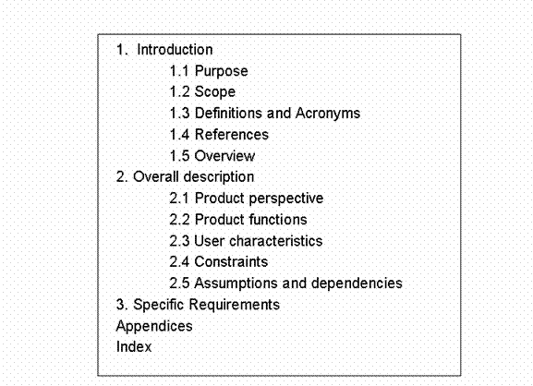
IEEE 830
Recommended Table of Contents for an SRS from IEEE Standard 830 –1998.

Slide 15
ISO/IEC/IEEE 29148-2011
Supersedes IEEE 830
Information items (documents):
Stakeholder Requirements Specification (StRS) [highest level]
System Requirements Specification (SyRS) [content]
Software Requirements Specification (SRS) [most detailed]
Available on IEEE website:
http://ieeexplore.ieee.org/stamp/stamp.jsp?arnumber=6146379

Slide 16
StRS (IEEE 29148)
Describes the organization's motivation
Why the system is being developed or changed
Often referred to as the business requirement specification (BRS)
Defines processes and policies/rules under which the system is used
Documents the top-level requirements from the stakeholder perspective
Needs that a given stakeholder has
How that stakeholder will interact with a solution
Typical types of stakeholder requirements included in the StRS:
organizational/business requirements
high-level statements of the goal, objectives, or needs of the enterprise
user requirements
needs of users/operators/maintainers as derived from the context of use

Slide 17
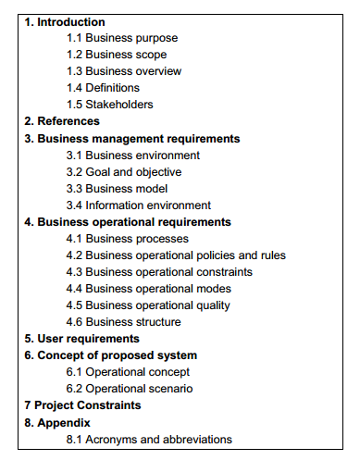
Example StRS Outline

Slide 18
StRS Content – Section 1
Business purpose: The reason and background for which the organization is pursuing new business or changing the current business in order to fit a new management environment
Business scope:
Identify the business domain by name
Define the range of business activities included in the business domain concerned
Describe the scope of the system being developed or changed
Business overview:
Major internal divisions and external entities of the business domain concerned and how they are interrelated (diagram recommended)
Stakeholders:
List the stakeholders or the classes of stakeholders
Describe how they will influence the organization and business
Describe how they are related to the development and operation of the system

Slide 19
StRS Content – Section 3
Business environment: External and internal environmental factors that should be taken into consideration in understanding the new or existing business
Market trends, laws and regulations, social responsibilities, and technology base
Goal and objective: the business results to be obtained through or by the proposed system
Business model: methods by which the business goal is expected to be achieved
Products and services, geographies and locales, distribution channels, business alliance and partnership, and finance and revenue model
Information environment:
project portfolio – priority, relative positioning, and possible constraints of related projects
long term system plan – common system infrastructure or architecture, constraints on possible design decisions
database configuration – an organization-level database configuration plan

Slide 20
StRS Content – Section 4
Business processes: The procedures of business activities and possible system interfaces within the processes
Operational policies and rules: Logical propositions applied in conducting the business processes
Operational constraints: Conditions to be imposed in conducting the business process
Operational modes: Methods to conduct the business operation in an unsteady state
Operational quality: Level of quality required for the business operation
Business structure: the structures in the business relevant to the system, such as organizational structure (divisions and departments), role and responsibility structures, geographic structures, and resource sharing structures

Slide 21
SyRS (IEEE 29148)
Provides a description of what the system should do
Interactions or interfaces with external environment
Includes inputs, outputs, and required relationships between inputs and outputs
Communicates the requirements of the acquirer to the technical community who will specify and build the system
Acts as the bridge between customer and developer
Needs to be understandable by both

Slide 22
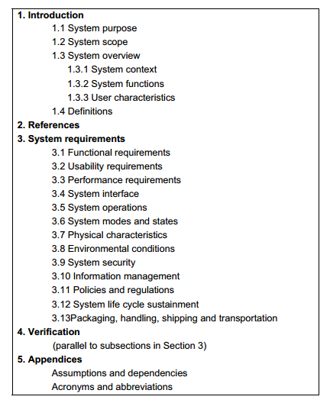
Example SyRS Outline

Slide 23
SyRS Content – Section 3 (1 of 2)
Functional Requirements: Functional requirements applicable to system operation
Usability Requirements: Measurable effectiveness, efficiency, and satisfaction criteria in specific contexts of use
Performance Requirements: Critical performance conditions and their associated capabilities
System Interface: Requirements for interfaces among system elements and with external entities
System Operations:
Human-system integration requirements: Allocation of functions to personnel
Maintainability: Quantitative maintainability requirements that apply to maintenance in the planned maintenance and support environment
Reliability: Quantitative reliability requirements, including the conditions under which the reliability requirements are to be met

Slide 24
SyRS Content – Section 3 (2 of 2)
System Modes and States: Modes or states in which the system can exist
Physical Characteristics:
Constraints on weight, volume and dimension
Requirements for growth, expansion, and contraction
Environmental Conditions: Environmental conditions to be encountered by the system
System Security: System security requirements related to both the facility that houses the system and operational security requirements of the system itself
Information Management: System's management of information that it receives, generates, or exports
Policies and Regulations: Any relevant organizational policies that will affect the operation or performance of the system
System Life Cycle Sustainment: Quality activities, such as review and measurement collection and analysis to help realize a quality system

Slide 25
SRS (IEEE 29148)
Specifies a particular software product, program, or set of programs that performs certain functions in a specific environment
May be written by one or more representatives of the supplier, one or more representatives of the acquirer, or both
Includes:
All of the required capabilities of the specified software product
Precedence and criticality of requirements
Conditions and constraints under which the software has to perform
Intended verification approaches for the requirements

Slide 26
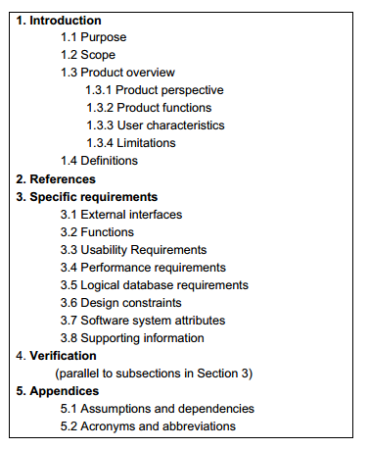
Example SRS Outline

Slide 27
SRS Content – Section 3 (1 of 2)
External Interfaces: All inputs into and outputs from the software system
Functions: The fundamental actions that have to take place in the software in accepting and processing the inputs and in processing and generating the outputs
Usability Requirements: Measurable effectiveness, efficiency, and satisfaction criteria in specific contexts of use
Performance Requirements: Static and the dynamic numerical requirements placed on the software or on human interaction with the software as a whole
Logical Database Requirements: Logical requirements for any information that is to be placed into a database
Design Constraints: Constraints on the system design imposed by external standards, regulatory requirements, or project limitations
Standards Compliance: Requirements derived from existing standards or regulations

Slide 28
SRS Content – Section 3 (2 of 2)
Software System Attributes: non-functional requirements
Reliability
Availability
Security
Maintainability
Portability

Slide 29
Benefits of Using an RE Standard
Establishes the basis for agreement between the customers and the suppliers on what the software product is to do
Assists potential users in determining if the software meets their needs
Provides an outline for document organization
Has been widely deployed across application domains
Provides guidance for organizing requirements

Slide 30
Benefits of an RE Standard
Reduces development effort
Forces groups in the customer’s organization to consider rigorously all of the requirements
Reduces later redesign, recoding, and retesting
Careful review of the requirements in the SRS reveals omissions, misunderstandings, and inconsistencies
Promotes earlier correction of requirements problems

Slide 31
Benefits of an RE Standard
Provides a basis for estimation
For estimating project costs [COCOMO1 & COCOMO2]
For estimating project schedules
For obtaining approval
For obtaining bids and price estimates

Slide 32
Benefits of an RE Standard
Provides a baseline for validation and verification
Organizations can develop their validation and verification plans much more productively from a good SRS
The SRS provides a baseline contract against which compliance can be measured
QUIZ: Who is Intended audience, author. ?
Info about business process- stakeholder requirement doc/ business require doc

Slide 33
Benefits of an RE Standard
Facilitates transfers
The SRS makes it easier to transfer the software product to new users or new machines
Customers find it easier to transfer the software to other parts of their organization, suppliers and to new customers

Slide 34
Benefits of an RE Standard
Serves as a basis for enhancement
Because the SRS discusses the product – not the development process
The SRS may need revision, but it provides a foundation for continued production evaluation

Slide 35
Backup Slides

Slide 36
Preferred Specification Representation
There is no “silver bullet” -- each system should be considered on its own merits.
Best practices include:
Use consistent modeling approaches and techniques throughout the specification, for example, a top-down decomposition, structured or object-oriented approaches
Separate operational specification from descriptive behavior
Use consistent levels of abstraction within models and conformance between levels of refinement across models
Model non-functional requirements as a part of the specification models – in particular timing properties
Omit hardware and software assignment in the specification (another aspect of design rather than specification)

Slide 37
Text Structure
Number of statement identifiers at each hierarchical level
High level requirements rarely have numbered statements below a depth of 4 (e.g. 3.2.1.5).
Well organized documents have a pyramidal structure to the requirements
Requirements with an hourglass structure mean too many administrative details
Diamond structured requirements indicate subjects introduced at higher levels were addressed at different levels of detail

Slide 38
Text Structure
1, 2, 3,4, 5, 6, 7, 8, 9, 10
1.1, 1.2, 2.1, 2.2
1.1.1, 2.1.1
1.1.1.1, 1.2.1.1
1.1.1.1.1, 1.1.1.1.2, 1.2.1.1.2
1, 2, 3
1.1, 1.2, 2.1, 2.2
1.1.1, 1.1.2, 1.2.1, 1.2.2, 2.1.1
1.1.1.1, 1.1.1.2, 1.1.2.1, 1.1.2.2, 1.2.1.1,…
1.1.1.1.1, 1.1.1.2.1, 1.1.2.2.1, 1.1.2.2.2
1.1.1.1.1.1, 1.1.2.2.1.1
1, 2, 3
1.1, 1.2, 2.1, 2.2
1.1.1, 1.1.2, 1.2.1, 1.2.2, 2.1.1
1.1.1.1, 1.1.1.2, 1.1.2.1, 1.1.2.2, 1.2.1.1,…
a)
b)
c)

Slide 39
Bad Habits in Requirements Specification
Mixing of operational and descriptive specifications
Combining low-level hardware functionality and high level systems and software functionality in the same functional level
Omission of timing information

Slide 40
Best Practices
Bad:
The system shall be completely reliable.
The system shall be modular.
The system will be fast.
Errors shall be less than 1%.
Better:
Response times for all level one actions will be less than 100 ms.
The cyclomatic complexity of each module shall be in the range of 10 to 40.
95% of the transactions shall be processed in less than 1 sec.
MTBF shall be 100 hours of continuous operation.

Slide 41
Functional Requirements
All system inputs
Exact sequence of operations and responses (outputs) to normal and abnormal situations for every input possibility
May use case-by-case description or other general form of description (e.g., using universal quantification, use cases, user stories)

Slide 42
Functional Requirements (IEEE 830)
Specific requirements may be organized by:
Functional mode (e.g., navigation, attack, diagnostic)
User class (e.g., user, supervisor, diagnostic)
Object (define classes/objects, attributes, functions/methods, messages)
Feature (what the system provides to the user)
Stimulus (e.g., sensor 1, 2,…)
Functional hierarchy (e.g., using structured analysis)
Mixed (combining two or more of the above)

Slide 43
Representing Nonfunctional Requirements
IEEE 830 defines several types of nonfunctional requirements:
External interfaces
Performance
Logical database
Design constraints
Software system attributes

Slide 44
External Interface Requirements
Name of item
Description of purpose
Source of input or destination of output
Valid range, accuracy, and/or tolerance
Units of measure
Timing
Relationships to other inputs/outputs
Screen formats/organization
Window formats/organization
Data formats
Command formats

Slide 45
Performance Requirements
Static and dynamic requirements placed on the software or on human interaction with the software as a whole
Might include:
The number of simultaneous users to be supported
The numbers of transactions and tasks the amount of data to be processed within certain time periods for both normal and peak workload conditions
Others?

Slide 46
Logical Database Requirements
Types of information used by various functions such as
Data entities and their relationships
Frequency of use
Accessing capabilities
Integrity constraints
Data retention requirements

Slide 47
Design Constraint Requirements
Related to :
Standards compliance
Hardware limitations

Slide 48
Software System Attribute Requirements
Reliability
Availability
Security
Maintainability
Portability
Just about any other “ility” you can think of

Slide 49
Use Cases
Describe scenarios of operation of the system
Described typically using Use Case Diagram, which depicts the interactions of the software system with its external environment.
Boxes represents the system itself.
Stick figures represent “actors” that designate external entities that interact with the system
Actors can be humans, other systems, or device inputs
Internal ellipses represent each activity of use for each of the actors (use cases)
Solid lines associate actors with each use
The picture is not a use case – it is a representation of a use case

Slide 50
Use Case Example (Pet Store POS)
Pet Store POS
Refund Account
Customer
Update
Inventory
Approve
Cashier
Manager
Partial use case diagram – issuing a refund

